Slide 2
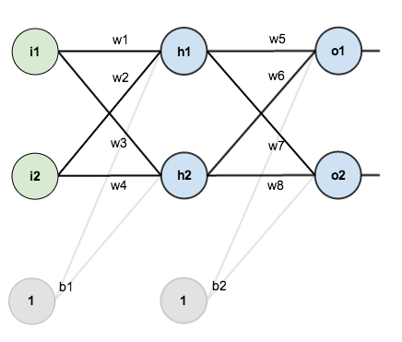
Here’s the basic structure:
Here’s the basic structure:

Slide 3
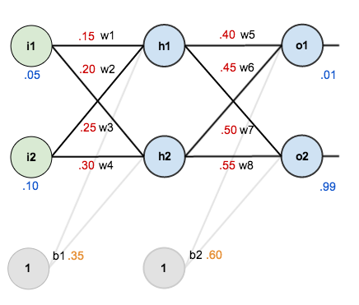
In order to have some numbers to work with, here are the initial weights, the biases, and training inputs/outputs:
given inputs 0.05 and 0.10, we want the neural network to output 0.01 and 0.99.

Slide 4
Here’s how we calculate the total net input for :
We then squash it using the logistic function to get the output of :
Carrying out the same process for h2 we get:

Slide 5
We repeat this process for the output layer neurons, using the output from the hidden layer neurons as inputs.
Here’s the output for
:
And carrying out the same process for O2 we get:

Slide 6
For example, the target output for is 0.01 but the neural network output 0.75136507, therefore its error is:
Repeating this process for (remembering that the target is 0.99) we get:
The total error for the neural network is the sum of these errors:

Slide 7

Consider . We want to know how much a change in affects the total error, aka .
is read as “the partial derivative of with respect to “. You can also say “the gradient with respect to “.
By applying the chain rule we know that:

Slide 8
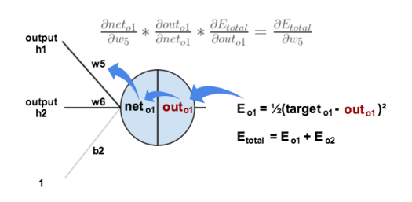
Visually, here’s what we’re doing:
We need to figure out each piece in this equation.

Slide 9
First, how much does the total error change with respect to the output?

Slide 10
The partial derivative of the logistic function is the output multiplied by 1 minus the output:

Slide 11
Finally, how much does the total net input of change with respect to W5
Putting it all together:

Slide 12
To decrease the error, we then subtract this value from the current weight (optionally multiplied by
some learning rate, eta, which we’ll set to 0.5):
We can repeat this process to get the new weights
:

